Slide 1

Registration system for Dammam Community College
Team#3:
Saleh Aljamea 201931910
Adi Sendi 201779270
Abdulmohsen Altamimi 202133490
Osama Alghamdi 201846580
Abdulrahman Alduhailan 201949150
Turki Harbi 201729530
Instructor: Amine Nehari Talet
MIS301

Slide 2
Introduction
We choose DCC Registration system because one of group member had experienced with it. It was not a good experience for him using the system
We have worked as a group with the registrar MR. Ovais Khan of DCC in-person meeting, also we have communicated online with him.
Our objective is Improving registration system for students at Dammam Community College to help the college administration system

Slide 3
Description of the existing system
The registration system for DCC built in house by Mr. Khan
The goals of the registration system to enable the student to add or drop their courses

Slide 4
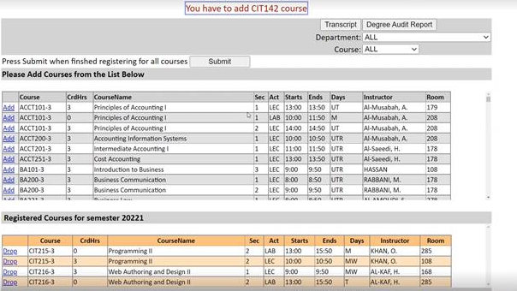
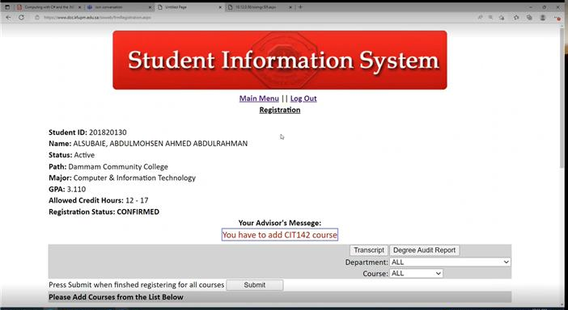
Description of the existing system

Slide 5
Problems with the existing system
The system UI was not that appealing for the users
Lack of feature for example there no e-petition and waitlist option
no CRNs to their sections and no documentation

Slide 6
Solution for the existing system
Developing new UI to make interactive to the users of the system
A better back end and documentation are improved to reduce individual mistakes
Automated some process that do it manually

Slide 7
Request Petition

Slide 8
Add/Drop Course

Slide 9
Select term
View Schedule

Slide 10
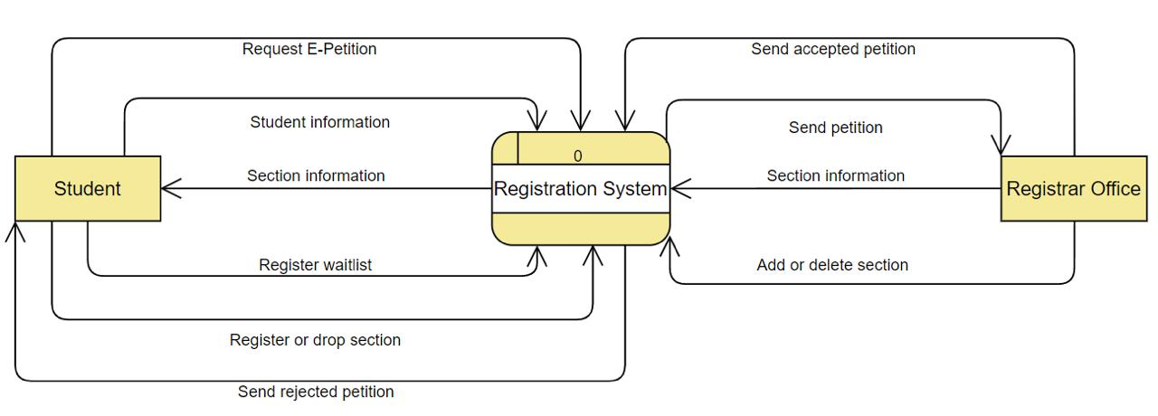
DFD for the system
Context Diagram

Slide 11
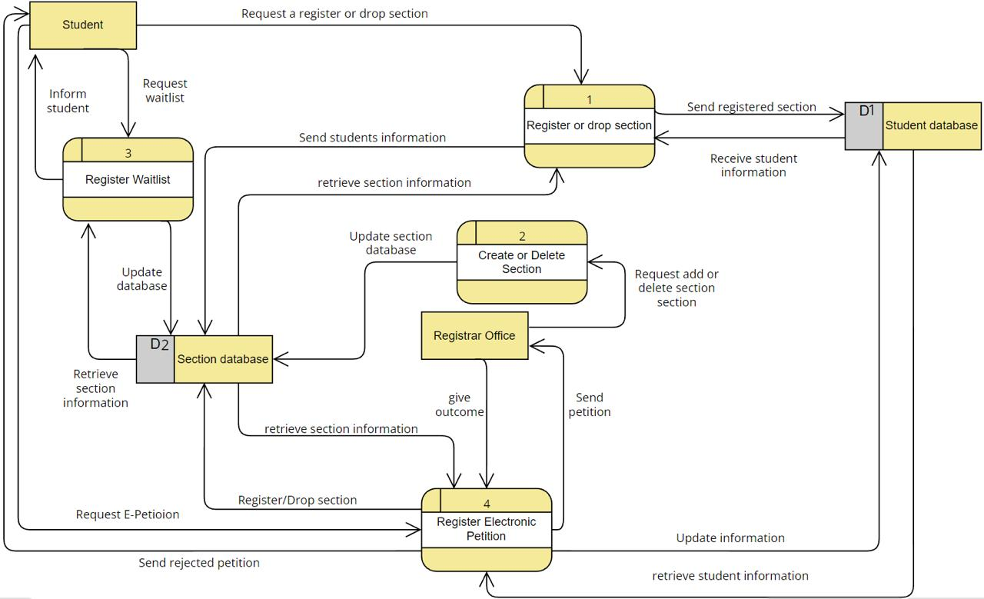
DFD for the system
Level 0

Slide 12
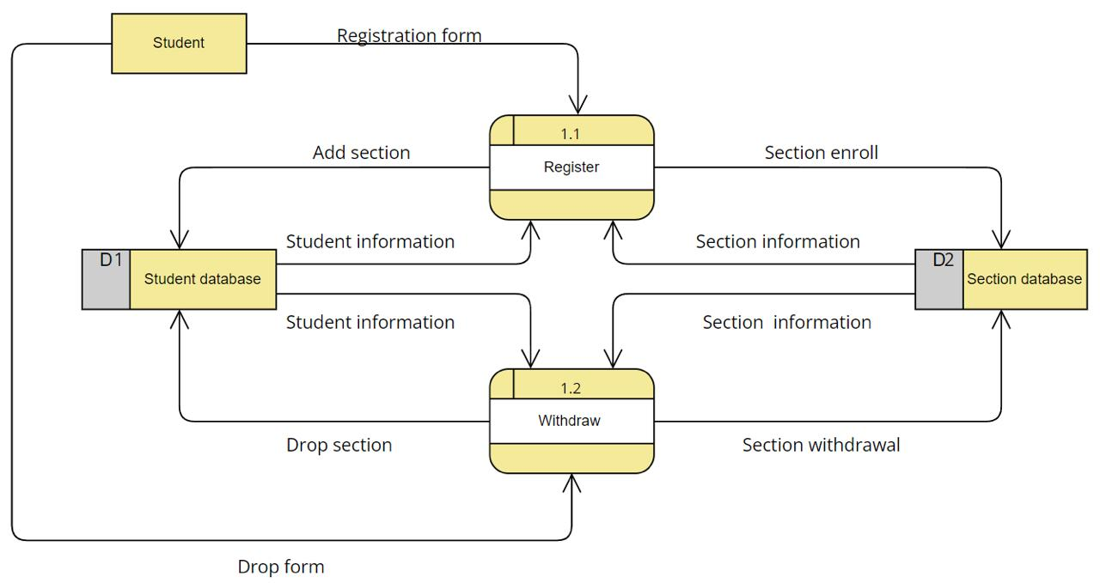
DFD for the system
Level 1

Slide 13
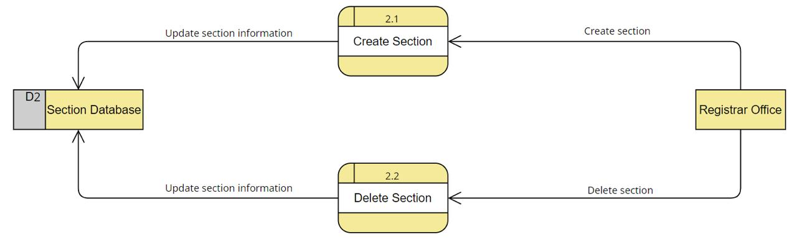
DFD for the system
Level 1

Slide 14
ERD for the system
1NF

Slide 15
ERD for the system
2NF

Slide 16
ERD for the system
3NF

Slide 17
Lesson learned
We have improved our communication skills through communicating with Mr. Ovais Khan
we also gained professional knowledge on how to work as a team which will be helpful for all of us in the future
making the use cases and the DFD and ERD, acquired knowledge on how to develop the data dictionary and the use case diagram

Slide 18
Thanks

